Slide 1
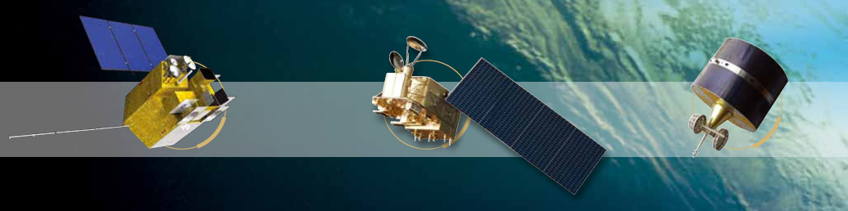
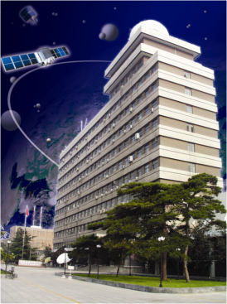


FengYun satellites & data
Liu Jian and Xian Dian
National Satellite Meteorological Center, CMA
NAEDEX/APSDEU 2015-10 ,Montreal, Canada

Slide 2
FengYun satellites & data
Satellite status
Data dissemination
Satellite data application

Slide 3
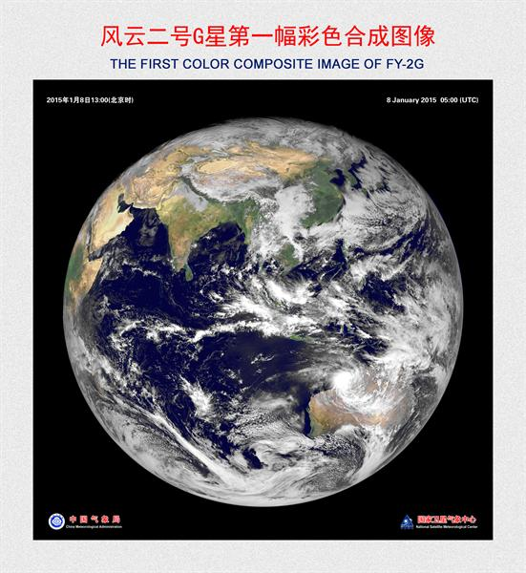
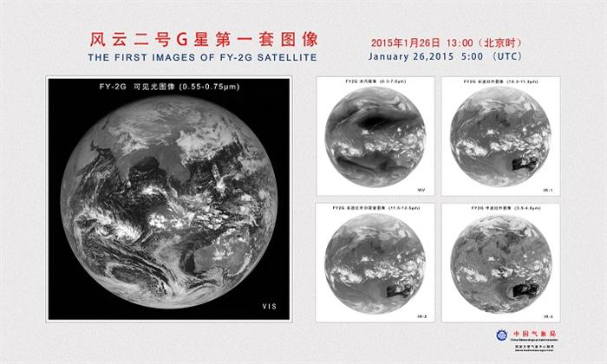
satellite status- FY-2
FY-2G has been successful launched on December 31 2014.

Slide 4
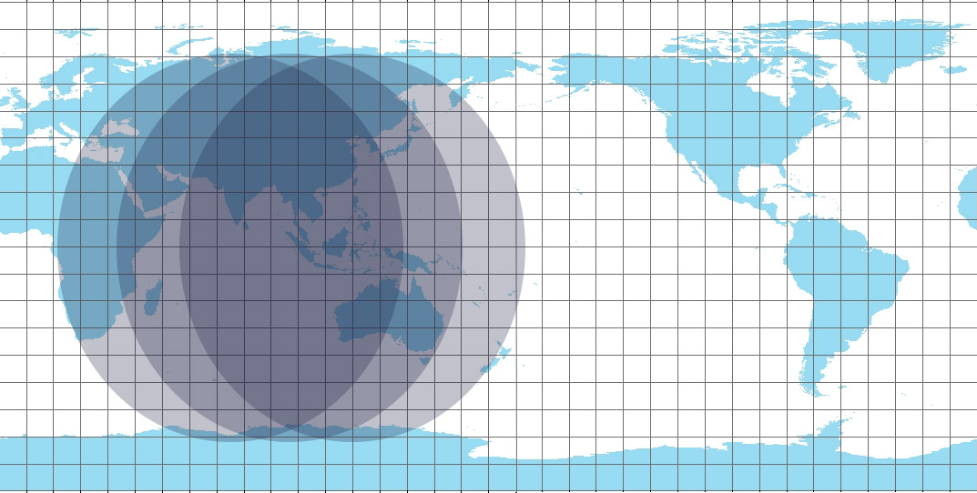

satellite status- FY-2
Position | Satellite | Status
86.5°E | FY-2E | Operation (from June 29th 2015 instead of FY-2D, operational until Jun 2nd 2015 at 105E)
105°E | FY-2G | Operation (from June 3rd 2015 instead of FY-2E)
112°E | FY-2F | Operation (Regional observation on demand)
123.5°E | FY-2D | Backup (Stop observation at 86.5E from June 30th 2015)
FY-2G
FY-2D
FY-2E
FY-2F

Slide 5
satellite status- FY-3
FY-3A
Due to the result of temperature drop in the payload envelope of FY-3A satellite, VIRR and MERSI work out of the normal range of temperature condition, their measurements became useless for quantitative application; other FY-3A payloads for DBS (namely, MWTS, MWHS, and IRAS) had stopped working before. In view of this, response to request for service of FY-3A DBS software package is no longer available from August 2014.
FY-3C
operational service was suspended since 31 May 2015 due to technical reason.
the instruments on FY-3C was switched on at 8:00AM (Beijing Time) 30 July 2015 to make observation again. These instruments are VIRR, MWRI, MWHS,GNOS, IRAS, and TOU.

Slide 6
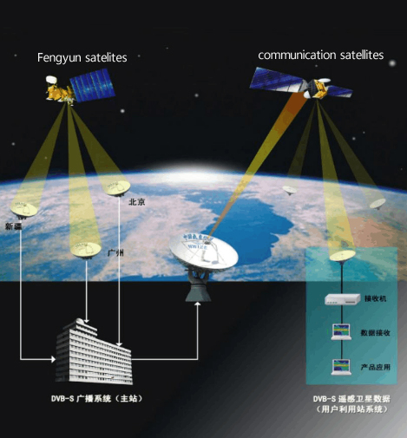
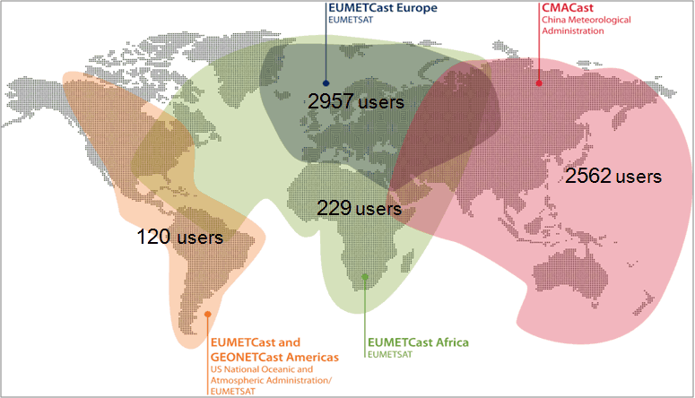
data dissemination
Direct Broadcast
CMACast
Notes:
CMACast is based on DVB-S2 technology with both file and multimedia transmission capability. It distributes meteorological data and satellite sensing data to users in China and Asia-Pacific region. It is a major component of CMA national and international meteorological data transmission network and the main media for national and international data dissemination. CMACast is also a component of WMO/IGDDS and GEONETCast system, and has data exchange and re-dissemination capability with EUMETCast and GEONETCast Americas.

Slide 7
data dissemination_CMACast in the next 10 years
CMACast is using a entire 36MHz C-band transponder of AsiaSat 4 and its data rate is 70Mbps data rate at DVB-S2, 8PSK, FEC 5/6 .
Due to Limitation of C band satellite transponder, coverage and bandwidth of CMACast will not be improved in the next 10 years.
CMA will balance the amount of data distributed over terrestrial network and Satellite transponder and provide more bandwidth for GEOSS Data broadcast.

Slide 8
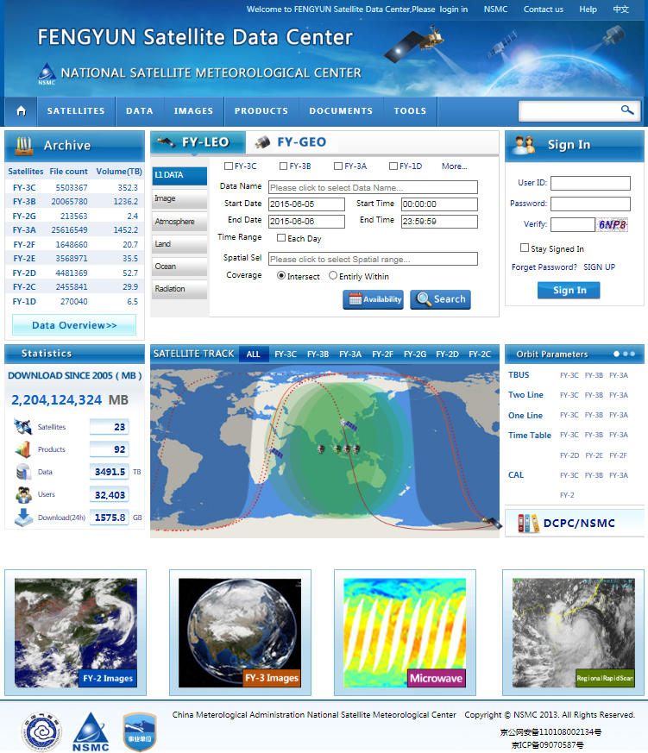
data dissemination
http://www.nsmc.org.cn
All archived data (real time)
Satellite information
Daily global browse
Documents and tools

Slide 9

Very closer collaborations among four centers
for FengYun satellite data assimilation
Share; early evaluation; preparation before launch
ECMWF(User)
Feedback
UKMO(User)
Feedback
Improved FengYun Satellite Data Assimilation
CMA/NWPC(User)
Feedback
CMA/NSMC (Agency) Basic and general support
The telecommunication conference is held every 3 month since Dec 2014 to communicate the progress on evaluating, improving and assimilating FY-3C data in NWP models
Notes:
9

Slide 10
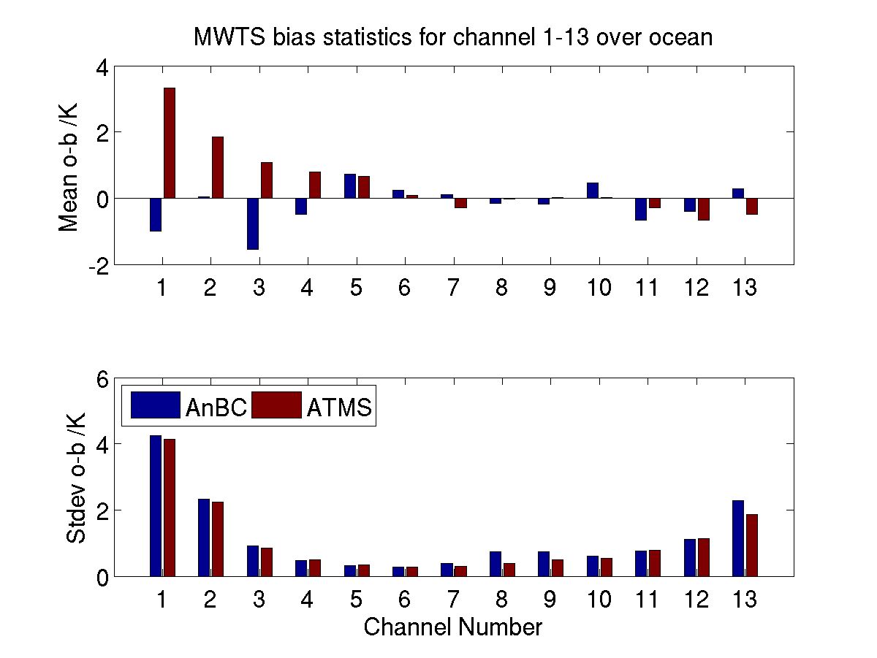
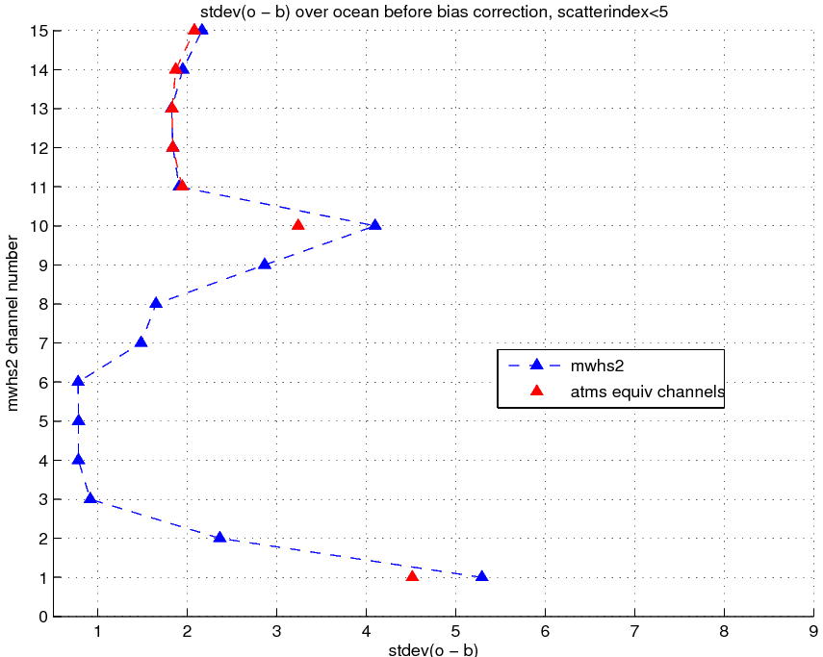
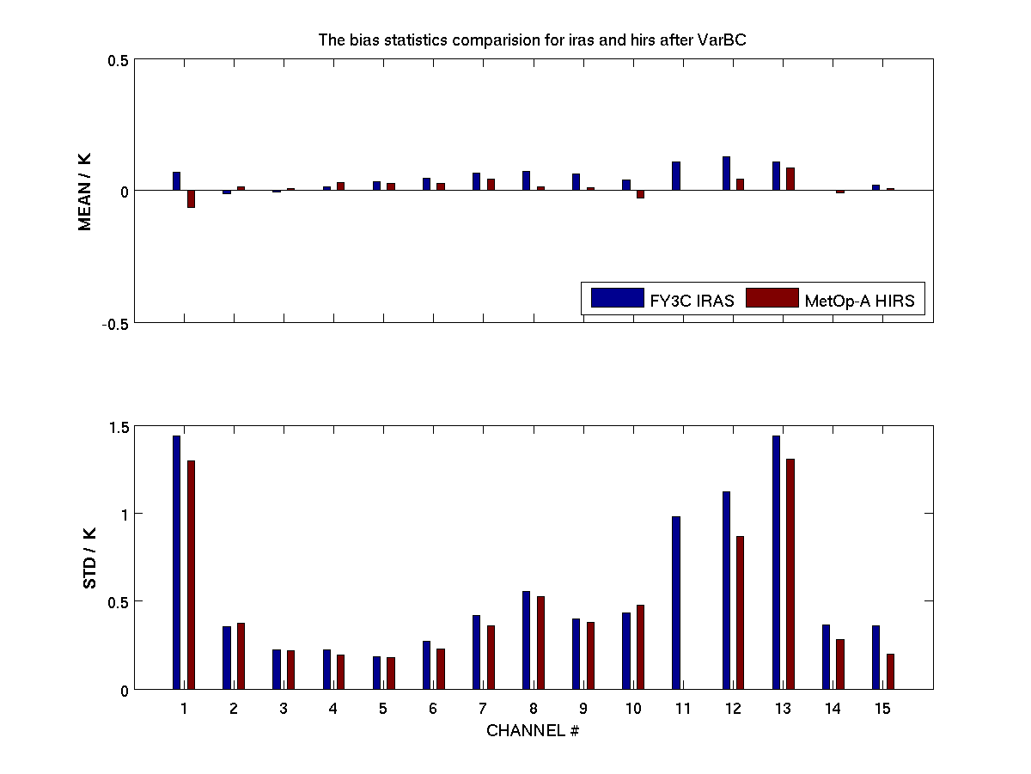
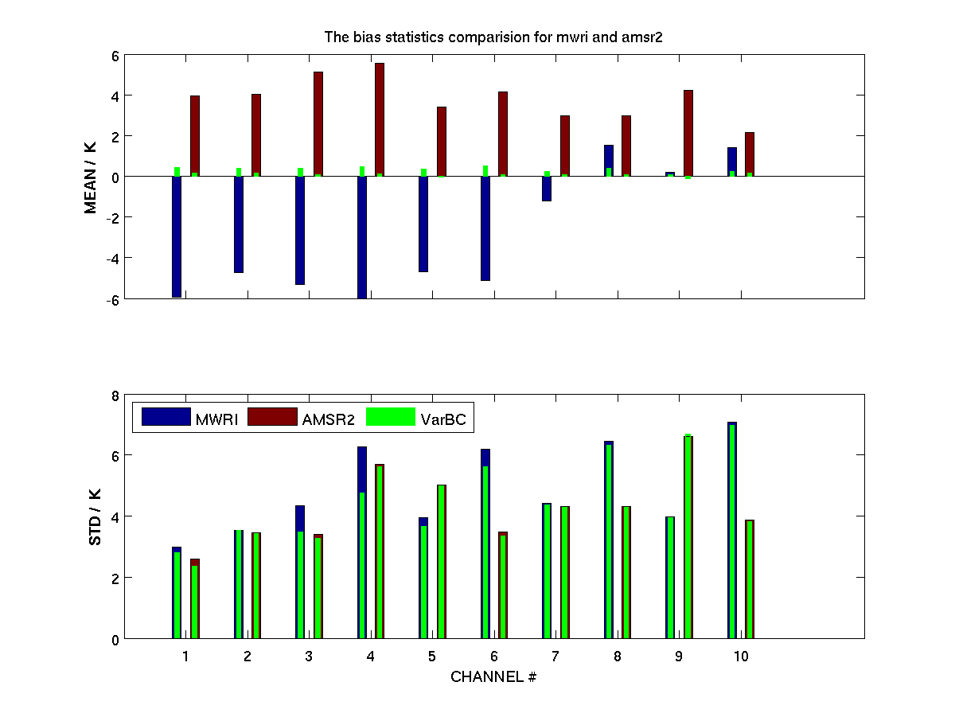
The comparable data quality of FY-3C sounding instruments to its counterparts
MWTS-2
MWHS-2 & ATMS
183 GHz
IRAS
MWHS-2 Channel
118 GHz
MWRI
stdev(o - b)/K
Channel

Slide 11
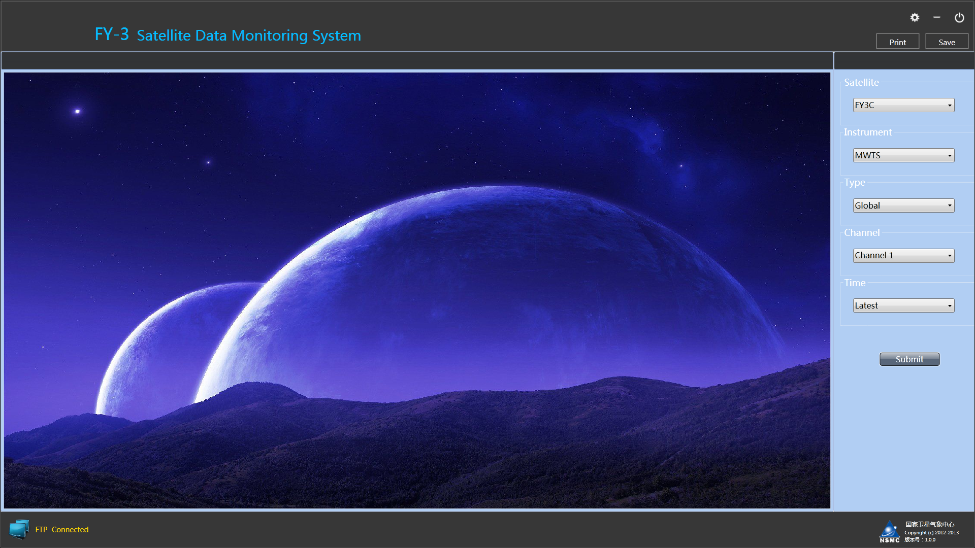
FY-3 data quality monitoring, bias diagnosis and correction system will be released soon to global users to support the operational assimilation through early anomaly warning

Slide 12
Data application
satellite Data in GRAPES_GFS
ATOVS microwave (NOAA15 16 17) radiances
NOAA-18/19 microwave radiance
Metop-A microwave radiance
GPS reflectivity
AIRS Hyper-spectral radiance
FY-2E wind
FY-3A /B microwave radiance
IASI Hyper-spectral radiance
NPP/ATMS microwave radiance
FY-3C/MWTS2 microwave radiance
2010 new data+ new operational version
Developed, but data ended
Developed + will be used
Developing

Slide 13

Thank You

